Slide 1


Antivirus for Beginners
What is Antivirus?
Antivirus is a computer program that helps protect your device from viruses and other dangerous software like malware, spyware, ransomware, and worms.
It works like a security guard for your computer.
by Ram N Java

Slide 2





What Does Antivirus Do?
Scans your files and programs to find anything harmful
Warns you if there is a virus or threat
Removes or blocks viruses before they can damage your computer
Keeps your personal information safe

Slide 3

Why Do You Need Antivirus?
It protects your computer from being damaged or hacked
It helps stop password theft and data loss
It lets you use the internet more safely
To stop hackers and malware from controlling your device

Slide 4





How Does Antivirus Work?
It has a list of known viruses (called virus definitions)
It checks all files and programs on your computer against this list
If it finds something harmful, it warns you or removes it
It also watches for new and unknown threats using smart tools

Slide 5








When Does Antivirus Work?
All the time in the background (real-time protection)
When you open a file or download something
When you visit websites – it can block unsafe ones
When you run a full system scan

Slide 6
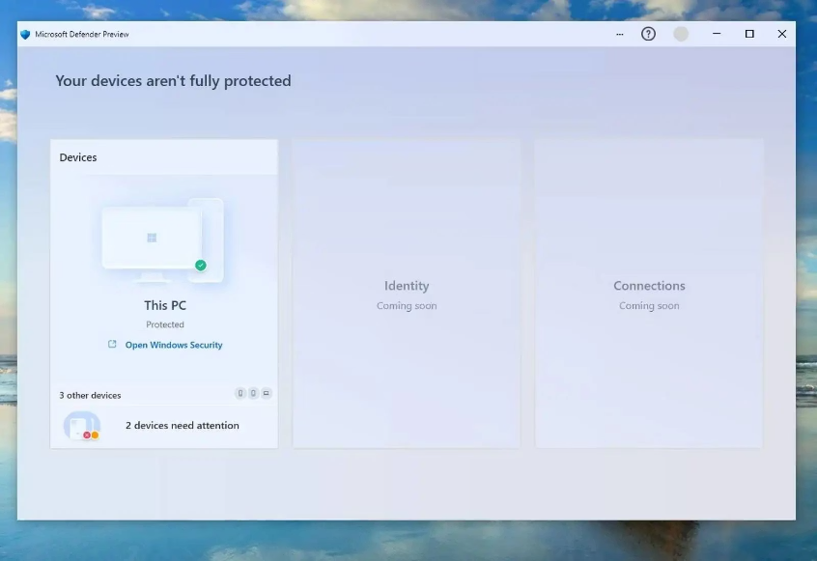
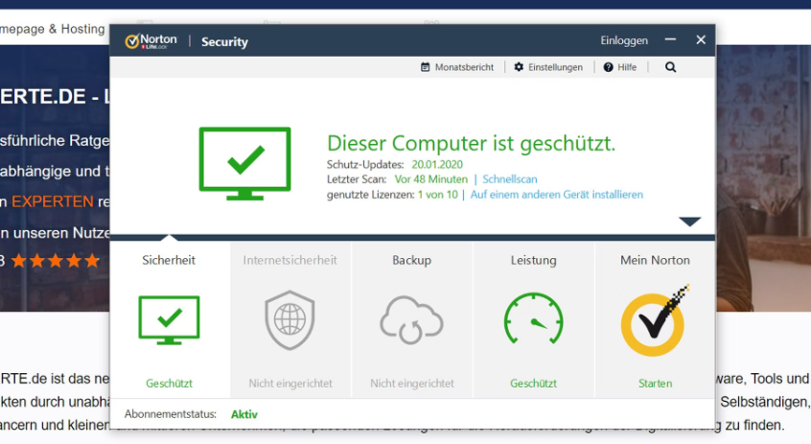
Types of Antivirus
Free Antivirus:
Paid Antivirus:
Basic protection (e.g., Windows Defender, Avast Free)
Advanced features like firewall, parental control, and identity protection (e.g., Norton, McAfee, Kaspersky)
Premium protection
Additional security tools
Limited features
Customer support
Basic virus scanning
Real-time protection

Slide 7

How to Use Antivirus
Install it on your computer or phone
Download from official sources and follow installation instructions
Update it regularly so it can catch new viruses
Enable automatic updates for best protection
Scan your system often to check for threats
Schedule weekly full system scans
Let it run in the background for real-time protection
Ensure real-time protection is always enabled

Slide 8

Good Habits with Antivirus
Keep antivirus updated
Do not turn it off, even if your computer is slow
Only install one antivirus program at a time
Listen to its warnings and follow the advice
Updates contain new virus definitions to protect against the latest threats
Temporary slowdowns are better than virus infections
Multiple antivirus programs can conflict with each other
Don't ignore security alerts from your antivirus software

Slide 9






Summary
Antivirus keeps your computer safe from harmful software
It works by finding, blocking, and removing viruses
You should always keep it on and up to date

